Slide 1
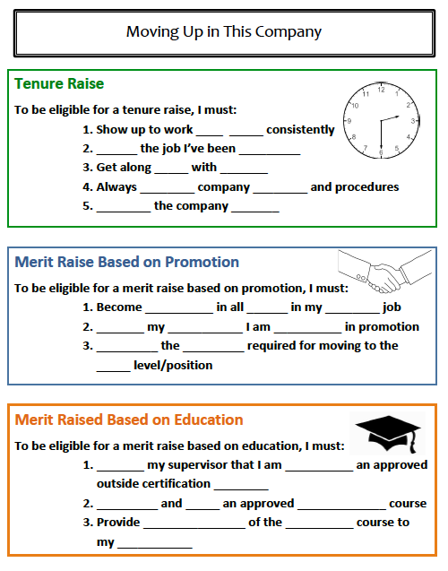
Moving Up In This Company

Slide 2
Tenure Raises
To be eligible for a tenure raise, I must:
Show up to work ____ _____ consistently
_______ the job I’ve been ___________
Get along ______ with ________
ON
TIME
LEARN
ASSIGNED
WELL
OTHERS

Slide 3
Tenure Raises
To be eligible for a tenure raise, I must:
Always ________ company _________ and procedures
__________ the company _________
FOLLOW
POLICIES
RESPECT
ASSETS

Slide 4
Merit Raises Based on Promotion
To be eligible for a merit raise based on promotion, I must:
Become __________ in all ______ in my ________ job
_______ my ____________ I am ___________ in promotion
COMPETENT
SKILLS
CURRENT
NOTIFY
SUPERVISOR
INTERESTED

Slide 5
Merit Raises Based on Promotion
To be eligible for a merit raise based on promotion, I must:
__________ the _________ required for moving to the _____ level/position
COMPLETE
TRAINING
NEXT

Slide 6
Merit Raises Based on Education
To be eligible for a merit raise based on education, I must:
_______ my supervisor that I am __________ an approved outside certification ________
NOTIFY
PURSUING
COURSE

Slide 7
Merit Raises Based on Education
To be eligible for a merit raise based on education, I must:
_________ and _____ an approved _____________ course
Provide _______________ of the __________ course to my ___________
COMPLETE
PASS
CERTIFICATION
DOCUMENTATION
COMPLETED
SUPERVISOR

